Slide 1

Operating System
Topic 5: Memory Management
Er. Nawaraj Bhandari

Slide 2
Introduction
Memory management is the functionality of an operating system which handles or manages primary memory and moves processes back and forth between main memory and disk during execution.
Memory management keeps track of each and every memory location, regardless of either it is allocated to some process or it is free. It checks how much memory is to be allocated to processes. It decides which process will get memory at what time. It tracks whenever some memory gets freed or unallocated and correspondingly it updates the status.

Slide 3
Process Address Space
The process address space is the set of logical addresses that a process references in its code. For example, when 32-bit addressing is in use, addresses can range from 0 to 0x7fffffff;
The operating system takes care of mapping the logical addresses to physical addresses at the time of memory allocation to the program. There are three types of addresses used in a program before and after memory is allocated −

Slide 4
Memory Addresses & Description
Symbolic addresses
The addresses used in a source code. The variable names, constants, and instruction labels are the basic elements of the symbolic address space.
Relative addresses
At the time of compilation, a compiler converts symbolic addresses into relative addresses.
Physical addresses
The loader generates these addresses at the time when a program is loaded into main memory.

Slide 5
Logical and Physical Address in Operating System
Logical Address is generated by CPU while a program is running. The logical address is virtual address as it does not exist physically, therefore, it is also known as Virtual Address. This address is used as a reference to access the physical memory location by CPU.
The term Logical Address Space is used for the set of all logical addresses generated by a program’s perspective. The hardware device called Memory-Management Unit is used for mapping logical address to its corresponding physical address.

Slide 6
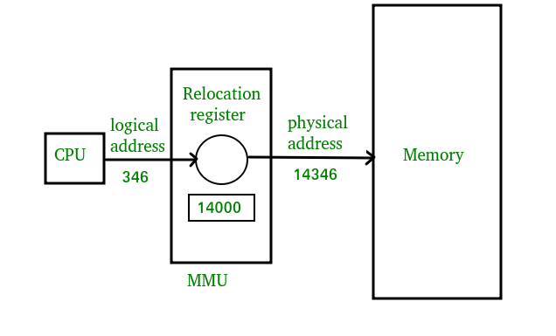
Logical and Physical Address in Operating System

Slide 7
Logical and Physical Address in Operating System
Physical Address identifies a physical location of required data in a memory. The user never directly deals with the physical address but can access by its corresponding logical address.
The user program generates the logical address and thinks that the program is running in this logical address but the program needs physical memory for its execution, therefore, the logical address must be mapped to the physical address by MMU before they are used.
The term Physical Address Space is used for all physical addresses corresponding to the logical addresses in a Logical address space.

Slide 8
Contiguous memory allocation
In contiguous memory allocation, all the available memory space remain together in one place. It means freely available memory partitions are not scattered here and there across the whole memory space.
In the contiguous memory allocation, both the operating system and the user must reside in the main memory. The main memory is divided into two portions one portion is for the operating and other is for the user program.

Slide 9
Contiguous memory allocation

Slide 10
Non-contiguous memory allocation
In the non-contiguous memory allocation the available free memory space are scattered here and there and all the free memory space is not at one place. So this is time-consuming. In the non-contiguous memory allocation, a process will acquire the memory space but it is not at one place it is at the different locations according to the process requirement.
This technique of non-contiguous memory allocation reduces the wastage of memory which leads to internal and external fragmentation. This utilizes all the free memory space which is created by a different process.

Slide 11
Non-contiguous memory allocation

Slide 12
Non-contiguous memory allocation
Non-contiguous memory allocation is of different types,
Paging
Segmentation
Segmentation with paging

Slide 13
Paging
A non-contiguous policy with a fixed size partition is called paging. A computer can address more memory than the amount of physically installed on the system. This extra memory is actually called virtual memory. Paging technique is very important in implementing virtual memory.
Secondary memory is divided into equal size partition (fixed) called pages. Every process will have a separate page table. The entries in the page table are the number of pages a process. At each entry either we have an invalid pointer which means the page is not in main memory or we will get the corresponding frame number.

Slide 14
Paging
When the frame number is combined with instruction of set D than we will get the corresponding physical address. Size of a page table is generally very large so cannot be accommodated inside the PCB, therefore, PCB contains a register value PTBR( page table base register) which leads to the page table.
Advantages: It is independent of external fragmentation.
Disadvantages:
It makes the translation very slow as main memory access two times.
A page table is a burden over the system which occupies considerable space.

Slide 15
Page Table
Page table is a data structure.
It maps the page number referenced by the CPU to the frame number where that page is stored.
Characteristics-
Page table is stored in the main memory.
Number of entries in a page table = Number of pages in which the process is divided.
Page Table Base Register (PTBR) contains the base address of page table.
Each process has its own independent page table.

Slide 16
Page Table
Page table is a data structure.
It maps the page number referenced by the CPU to the frame number where that page is stored.
Characteristics-
Page table is stored in the main memory.
Number of entries in a page table = Number of pages in which the process is divided.
Page Table Base Register (PTBR) contains the base address of page table.
Each process has its own independent page table.

Slide 17
Index
S. No. | Topic
1. | Paging
2. | Page Replacement
3. | Algorithms
 | Optimal FIFO NFU NRU LRU Second Chance CLOCK Random Working Set
4. | Conclusion
5. | References

Slide 18
Plan of Action
What is paging?
What is page replacement?
What are the types of page replacement?
Why we need a page replacement algorithm?
What are the algorithms?

Slide 19
What is Paging?
The OS divides virtual memory and the main memory into units, called pages.
Each used page can be either in secondary memory or in a page frame in main memory.
A frame does not have to comprise a single physically contiguous region in secondary storage.

Slide 20
What is page replacement?
When memory located in secondary memory is needed, it can be retrieved back to main memory.
Process of storing data from main memory to secondary memory ->swapping out
Retrieving data back to main memory ->swapping in

Slide 21
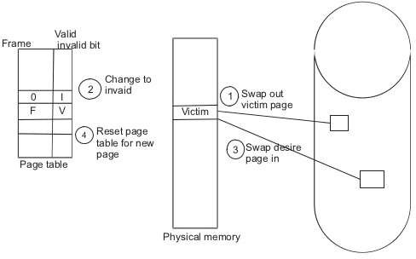
Fig: Page Replacement

Slide 22
What are Page Replacement Algorithms?
Deals with which pages need to be swapped out and which are the ones that need to be swapped in
The efficiency lies in the least time that is wasted for a page to be paged in

Slide 23
Types
Local Page Replacement Strategy
Global Page Replacement Strategy

Slide 24
Why we need a page replacement algorithm?
The main goal of page replacement algorithms is to provide lowest page fault rate.

Slide 25
START
Send Page request
FAULT
no
yes
HIT
Page found?
Fetch page
STOP

Slide 26
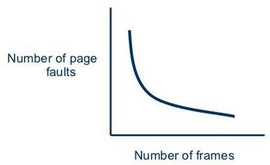
No. of Page Faults Vs No. of Frames

Slide 27
Algorithms
First In First Out
Optimal Replacement
Not Recently Used
Second Chance
CLOCK
Not Frequently Used
Least Recently Used
Random Replacement
Working Set Replacement

Slide 28
First-In First-Out (FIFO)
Pages in main memory are kept in a list
Newest page is in head and the oldest in tail
It does not take advantage of page access patterns or frequency

Slide 29
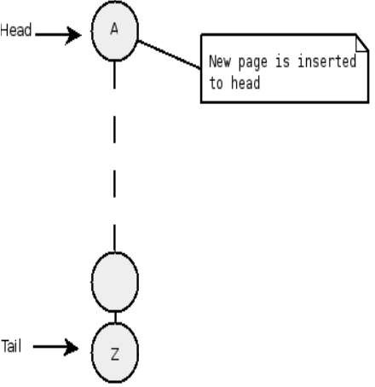
Fig: FIFO

Slide 30
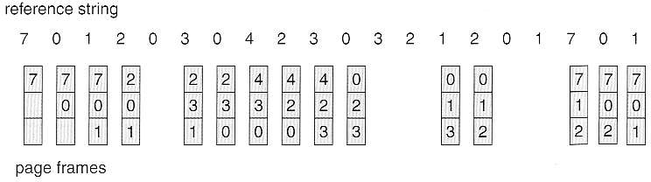

FIFO Example
Oldest
Newest
Hit
Hit
Hit
Fig: FIFO example

Slide 31
Optimal Replacement (OPT)
When the memory is full, evict a page that will be unreferenced for the longest time
The OS keeps track of all pages referenced by the program
Only if the program's memory reference pattern is relatively consistent

Slide 32
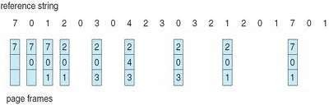
OPTIMAL Example
Referenced last
Hit Hit Hit
Hit
Hit
Hit
Fig: OPTIMAL example

Slide 33
Not Recently Used (NRU)
It favours keeping pages in memory that have been recently used.
The OS divides the pages into four classes based on usage during the last clock tick:
3. Referenced, modified
2. Referenced, not modified
1. Not referenced, modified
0. Not referenced, not modified

Slide 34
NRU
Pick a random page from the lowest category for removal
i.e. the not referenced, not modified page

Slide 35
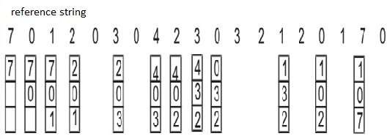
NRU Example
Recently referenced
Hit
Hit Hit Hit Hit
Hit
Fig: NRU example

Slide 36
Second Chance
Modified version of FIFO
Instead of swapping out the last page, the referenced bit is checked
Gives every page a "second-chance"

Slide 37
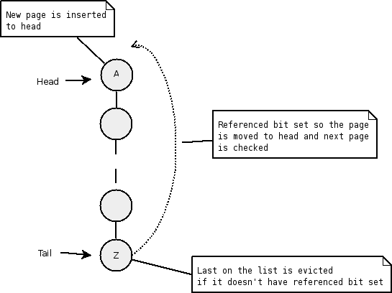
Fig: Second Chance

Slide 38
Clock
Modified version of FIFO
The set of frame candidates for replacement is considered as a circular buffer.

Slide 39
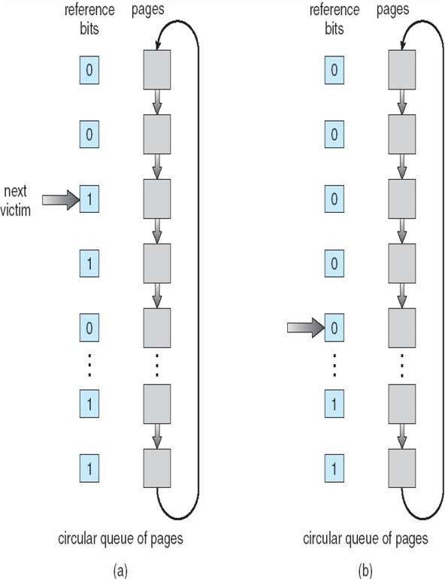
Fig: CLOCK

Slide 40
Least Recently Used (LRU)
It swaps the pages that have been used the least over a period of time.
It is free from Belady’s anomaly.

Slide 41
LRU Example
Recently referenced
Hit
Hit Hit Hit Hit
Hit
Fig: LRU example

Slide 42
Not frequently used (NFU)
This page replacement algorithm requires a counter
The counters keep track of how frequently a page has been used
The page with the lowest counter can be swapped out

Slide 43
reference sequence : 3 2 3 0 8 4 2 5 0 9 8 3 2
P U 3 | P U 2 | P U 3 | P U 0 | P U 8 | P U 4
+---+---+ | +---+---+ | +---+---+ | +---+---+ | +---+---+ | +---+---+
| | 0 |* | | 3 | 1 | | | 3 | 1 | | | 3 | 1 | | | 3 | 1 | | | 3 | 1 |
+---+---+ | +---+---+ | +---+---+ | +---+---+ | +---+---+ | +---+---+
| | 0 | | | | 0 |* | | 2 | 1 | | | 2 | 1 | | | 2 | 1 | | | 2 | 1 |
+---+---+ | +---+---+ | +---+---+ | +---+---+ | +---+---+ | +---+---+
| | 0 | | | | 0 | | | | 0 |* | | | 0 |* | | 0 | 1 | | | 0 | 1 |
+---+---+ | +---+---+ | +---+---+ | +---+---+ | +---+---+ | +---+---+
| | 0 | | | | 0 | | | | 0 | | | | 0 | | | | 0 |* | | 8 | 1 |
+---+---+ | +---+---+ | +---+---+ | +---+---+ | +---+---+ | +---+---+
| | 0 | | | | 0 | | | | 0 | | | | 0 | | | | 0 | | | | 0 |*
+---+---+ | +---+---+ | +---+---+ | +---+---+ | +---+---+ | +---+----
P U 2
P U 5
P U 0
P U 9
P U 8
P U 3
+---+---+
+---+---+
+---+---+
| 5 | 1 |
+---+---+
| 5 | 1 |
+---+---+
| 5 | 1 |
+---+---+
| 9 | 1 |
+---+---+
| 5 | 1 |
+---+---+
| 9 | 1 |
| 3 | 1 |*
+---+---+
| 2 | 1 |
+---+---+
| 0 | 1 |
+---+---+
| 8 | 1 |
+---+---+
| 4 | 1 |
+---+---+
| 3 | 1 |*
+---+---+
| 2 | 1 |
+---+---+
| 0 | 1 |
+---+---+
| 8 | 1 |
+---+---+
| 4 | 1 |
+---+---+
+---+---+
| 2 | 0 |*
+---+---+
| 0 | 0 |
+---+---+
| 8 | 0 |
+---+---+
| 4 | 0 |
+---+---+
+---+---+
| 2 | 0 |*
+---+---+
| 0 | 1 |
+---+---+
| 8 | 0 |
+---+---+
| 4 | 0 |
+---+---+
+---+---+
| 0 | 1 |*
+---+---+
| 8 | 0 |
+---+---+
| 4 | 0 |
+---+---+
+---+---+
| 0 | 1 |*
+---+---+
| 8 | 1 |
+---+---+
| 4 | 0 |
+---+----
P U 2 P U
+---+---+ +---+---+
| 5 | 1 |* | 5 | 0 |
| 9 | 1 | | 9 | 0 |
+---+---+ +---+---+
| 0 | 0 | | 2 | 1 |
+---+---+ +---+---+
| 8 | 0 | | 8 | 0 |*
+---+---+ +---+---+
| 3 | 1 | | 3 | 1 |
+---+---+ +---+---+
* = indicates the pointer which identifies the next location to scan P = page# stored in that frame U = used flag
0 = not used recently 1 = referenced recently
Fig: NFU example

Slide 44
Random
This algorithm replaces a random page in memory.
It fares better than FIFO.

Slide 45
Working set page replacement
The set of pages that a process is currently using is called the working set.
The working set algorithm is based on determining a working set and evicting any page that is not in the current working set upon a page fault.

Slide 46
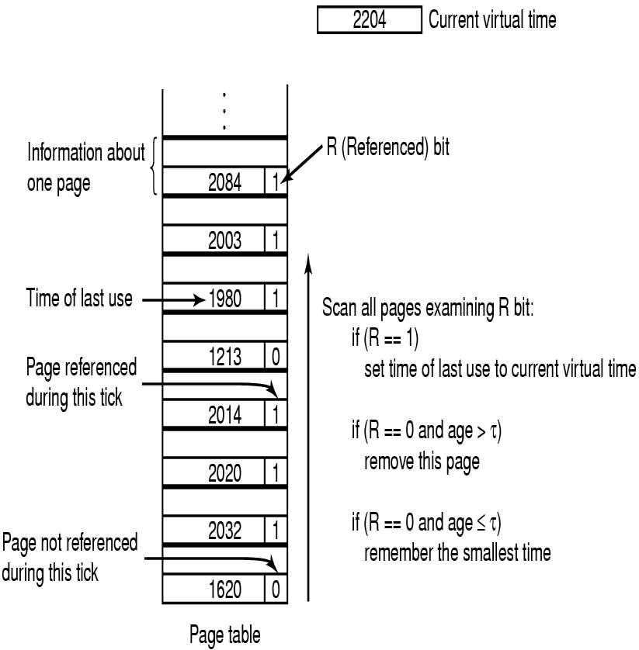

Slide 47
Conclusion
Algorithm
Comment
FIFO
OPTIMAL
LRU
NRU
NFU
Second Chance
CLOCK
Might throw out important
pages
Not implementable
Excellent but difficult to implement
Crude approximation of LRU
Crude approximation of LRU
Big improvement over FIFO
Realistic

Slide 48
Memory-management technique that permits the physical address space of a process to be non- contiguous
 Physical memory is divided into fixed size- blocks called FRAMES
 Logical memory is divided into blocks of the same size called PAGES
A frame
 has the same size as a page
 is a place where a (logical) page can be (physically) placed

Slide 49


There is another way in which addressable memory can be subdivided, known as
segmentation

Slide 50




 An important part of the memory management is
that become unavoidable with paging is the
separation of the user’s view of the memory and the actual physical memory
 The users view is mapped to the physical memory
 Thus the differentiation comes between the logical and physical memory.
Do users view memory as linear array of bytes some containing instruction and other containing data???
No…Rather they would see it
as collection of
segments…….

Slide 51

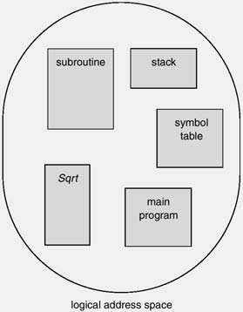
 User View of logical memory
Linear array of bytes
Reflected by the ‘Paging’ memory scheme
A collection of variable-sized
entities
User thinks in terms of “subroutines”, “stack”, “symbol table”, “main program” which are somehow located somewhere in memory.]
 Segmentation supports this user view. The logical address space is a collection of segments.

Slide 52
 Although the user can refer to objects in the program by a two-dimensional address, the actual physical address is still a one-dimensional sequence
 Thus, we need to map the segment number
 This mapping is effected by a segment table
 In order to protect the memory space, each entry in segment table has a segment base and a segment limit

Slide 53






Segment number
Logical Address space
Offset
The mapping of the logical address to the physical address is done with the help of the segment table.
the length of the
segment
SEGMENT TABLE
Segment Limit | Segment Base | Other bits
starting address of the corresponding segment in main memory
A bit is needed to determine if the segment is already in main memory (P)
Another bit is needed to determine if the segment has been modified since it was loaded in main memory (M)

Slide 54
 Segments are variable-sized
Dynamic memory allocation required (first fit, best fit, worst fit).
 External fragmentation
In the worst case the largest hole may not be large enough to fit in a new segment. Note that paging has no external fragmentation problem.
 Each process has its own segment table
like with paging where each process has its own page table. The size of the segment table is determined by the number of segments, whereas the size of the page table depends on the total amount of memory occupied.
 Segment table located in main memory
as is the page table with paging
 Segment table base register (STBR)
points to current segment table in memory
 Segment table length register (STLR)
indicates number of segments

Slide 55
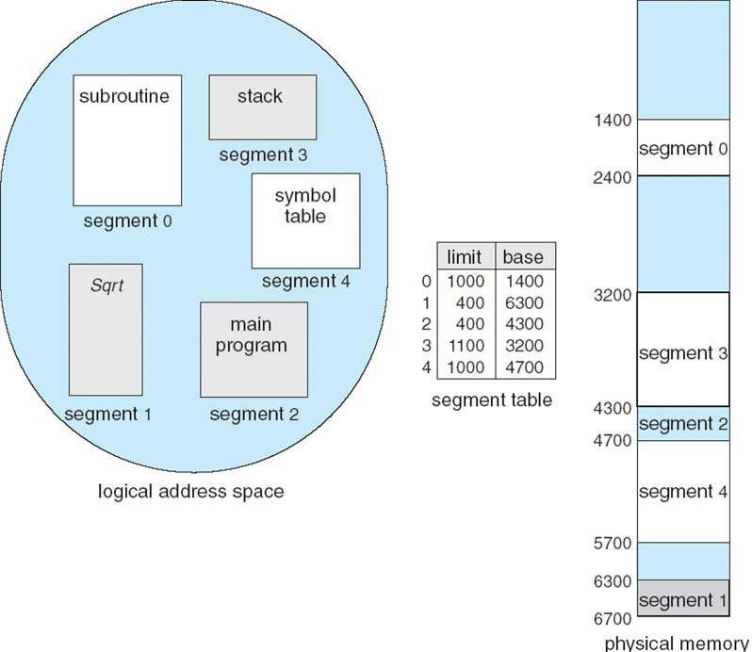

Slide 56
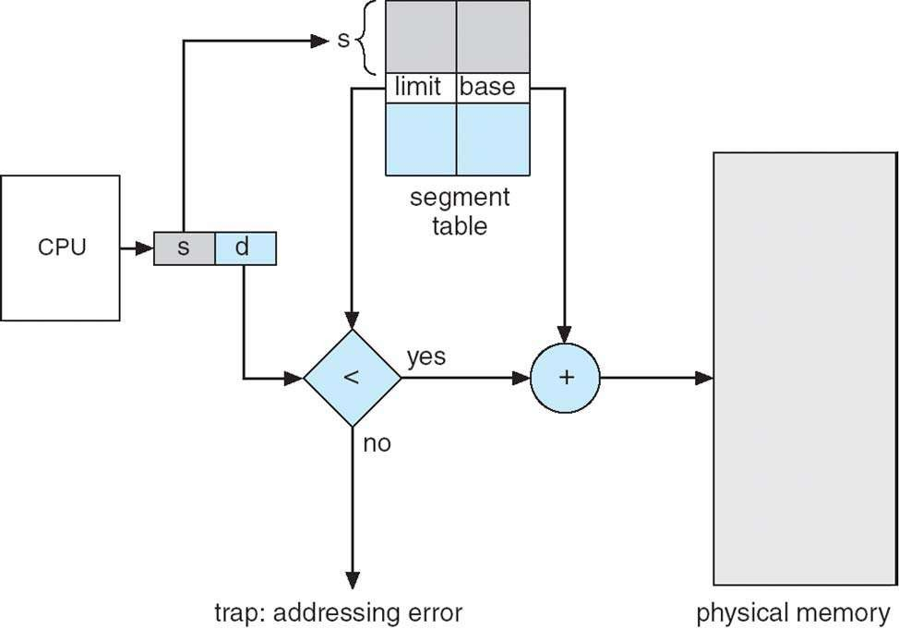

Slide 57
 Segmentation lends itself to the
implementation of protection and sharing policies
 Each entry has a base address and length so inadvertent memory access can be controlled
 Sharing can be achieved by segments referencing multiple processes
 Two processes that need to share access to a single segment would have the same segment name and address in their segment tables.

Slide 58
 Segment tables consume less memory than
 No internal fragmentation
page tables ( only one entry per actual segment as opposed to one entry per page in Paging method)
 Because of the small segment table, memory reference is easy
 Lends itself to sharing data among processes.
 Lends itself to protection.
 As the individual lines of a page do not form one logical unit, it is not possible to set a particular access right to a page.
 Note that each segment could be set up an access right

Slide 59
 External fragmentation.
 Costly memory management algorithm
 Unequal size of segments is not good in the case of swapping.

Slide 60
 With paging physical memory is divided into fixed-
size frames. When memory space is needed, as many free frames are occupied as necessary. These frames can be located anywhere in memory, the user process always sees a logical contiguous address space
 With segmentation the memory is not systematically
divided. When a program needs k segments (usually
these have different sizes), the OS tries to place these segments in the available memory holes. The segments can be scattered around memory. The user process does not see a contiguous address space, but
sees a collection of segments (of course each
individual segment is contiguous as is each page or
frame).

Slide 61
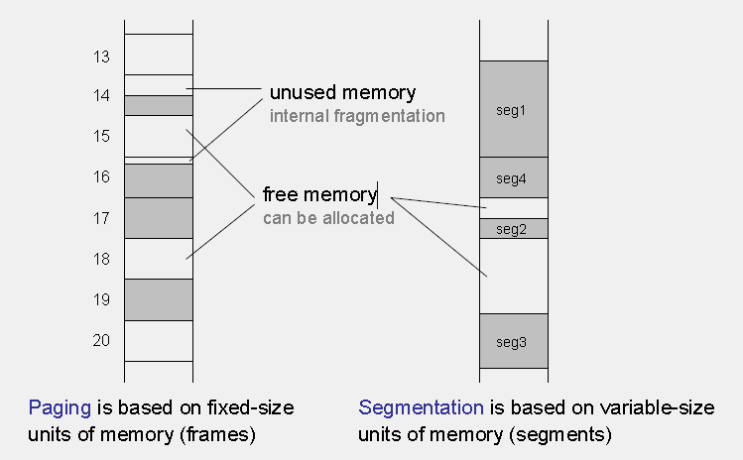

Slide 62
Paging
Segmentation
 Each process is assigned a segment table
 Segment table size proportional to number of segments
 Usually small segment tables
 External fragmentation.
 Lengthy search times when allocating memory to a process.
 Each process is assigned its page table.
 Page table size proportional to allocated memory
 Often large page tables and/or multi-level paging
 Internal fragmentation
 Free memory is quickly allocated to a process

Slide 63

THANK YOU !
“

